Slide 1
About
Children’s Ministry
Features
Luke
6:38
Give and it will be given to you:
Good measure, pressed down, shaken together,
running over, will be put into your lap .
Teamwork
Support
Events
News
Resources
Ideas
Blog

Slide 2
WHY CHILDREN’S MINISTRY
New Chapter
?

Slide 3
MinistryMemo
CHILDREN & FAMILY MINISTRY
Why is it so important?
About kids
I.
QUOTES:
About kids
About ministry
II.
KIDMIN QUOTES:
Encouragement
III.
MINISTRY:
Why be involved?
The challenge
IV.
THE CHALLENGE:
Challenge & the privilege..
V.
BALANCE:
Clock versus the compass
VI.
THE TEAM:
Ways that we can help you
VII.
REQUIREMENTS:
Ways we can minister
VIII.
CONTACT US:
For ideas & information
www.newchapter.com.au
3/14

Slide 4
MinistryMemo.
ABOUT
children
About kids
About ministry
The challenge
A rose can say ‘I love you’,
Orchids can enthrall,
But a weed bouquet in a chubby fist-
Yes, that says it all.
About kids:
Quotes
www.newchapter.com.au
4/14

Slide 5
MinistryMemo.
QUOTES
A child can ask questions a wise man
cannot answer.
Children who attend church as a child and learn the Bible when they are young have a much greater chance of having a relationship with Christ as adults.
www.newchapter.com.au
5/14

Slide 6
MinistryMemo.
BY THE AGE OF NINE…
most of the foundations of a child are in place.
About kids
About ministry
The challenge
MORAL
SPIRITUAL
SOCIAL
www.newchapter.com.au
6/14

Slide 7
GEORGE BARNA
MinistryMemo.
Barna Foundation
About kids
About ministry
The challenge
I believe the battlefront is found in the minds,
hearts and souls of our children.
RESEARCH SHOWS…
Most of those who accept Christ as Saviour do so before reaching the age of 13.
www.newchapter.com.au
7/14

Slide 8
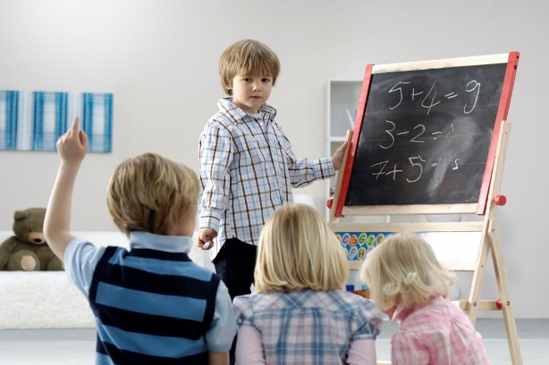
Quotes about children’s ministry
Take TIME for Kids
Important Work
It is easier to build strong children than to repair broken men. F. Douglas
If children‘s work is neglected you lose the next generation. P. Johnstone
If I could relive my life, I would devote my entire ministry to reaching children for God.
VP
21
The idea of changing the world is utter nonsense.. unless you‘re a children‘s pastor; then it may be possible.
HD
27
D.L. Moody
R. Fields
www.newchapter.com.au
8/14

Slide 9
www.newchapter.com.au
9/14
THE CHALLENGE
5%
Most adults believe
+ TEACH
ONLY 5%
children are important
+ ENCOURAGE
ARE ENGAGED
+ MINISTER
IN KIDS’ LIVES
AN INCREDIBLE PRIVILEGE TO:
*teach and minister to children & their families
*demonstrate Christ’s love
*introduce them to Christ at an early age
Kids go where there’s excitement; they stay where there’s love.
ZIG ZIGLAR
MinistryMemo.

Slide 10
BUT
WE NEED BALANCE
Our Vision/ Our Time

Slide 11
www.newchapter.com.au
11/14
THE
THE COMPASS
CHALLENGE OF
BALANCE- THE CLOCK
VERSUS THE COMPASS
All of us face the challenge of ministry & life balance- keeping the big picture, the compass, in mind.
+ Vision
+ Values
+ Direction
It’s so easy to focus on the clock- our commitments, appointments, schedules, goals, activities- our TIME.
+ Relationship with
God
MinistryMemo.

Slide 12
MinistryMemo.
THE TEAM
ways we can help
About kids
About ministry
Resources
Exciting, easy to teach programs
Bible Study
Extra content and study materials
Training
Regular training & webinars.
The challenge
Our team is here to help and support you.
Connection
Link to our social media for updates
Support
Encouragement & assistance
Inspiration
Ministry emails & newsletters .
www.newchapter.com.au
12/14

Slide 13
MinistryMemo.
CHILDREN & FAMILY MINISTRY
Requires:
About kids
Tc
Time/Creativity
Mi
More Issues
About ministry
The greatest amount of creativity, time & energy than any other department.
Attention to the greatest scope of issues from infant care to parenting & education.
The challenge
Sc
Sensitive Care
Di
Direct Impact
Care for the most vulnerable segment of society- kids today endure a wide range of abuse & fear.
Ministering for greatest impact on the future. (Kids still have a lifetime to devote to the Lord.)
“Thank you for choosing to be involved.”
www.newchapter.com.au
13/14

Slide 14
Thank you

