Slide 1
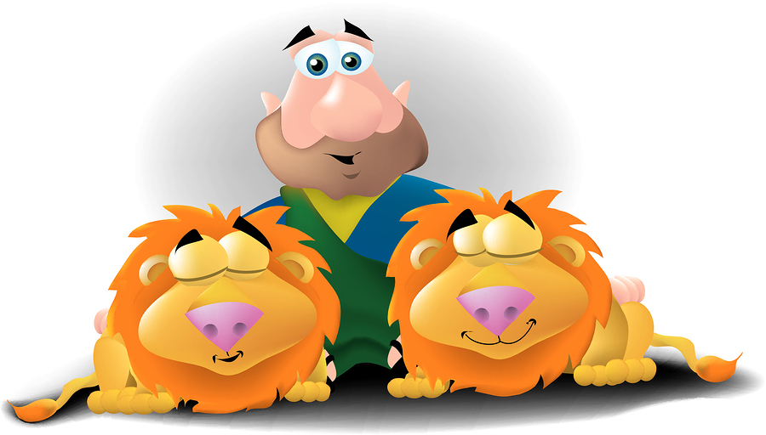
Spot the differences..
Find 5 things that are different in the following pictures to earn points for your team.

Slide 2
1.
Click on anything in picture 2 that is different from picture 1 to earn points for your team.
10pts
10pts
10pts
2.
10pts
10pts
Notes:
Use this game as a review of the story. Ask a question relating to the lesson- 10pts for a correct answer plus an additional 10pts if they can also spot a difference. Proceed with next question.

