Slide 1
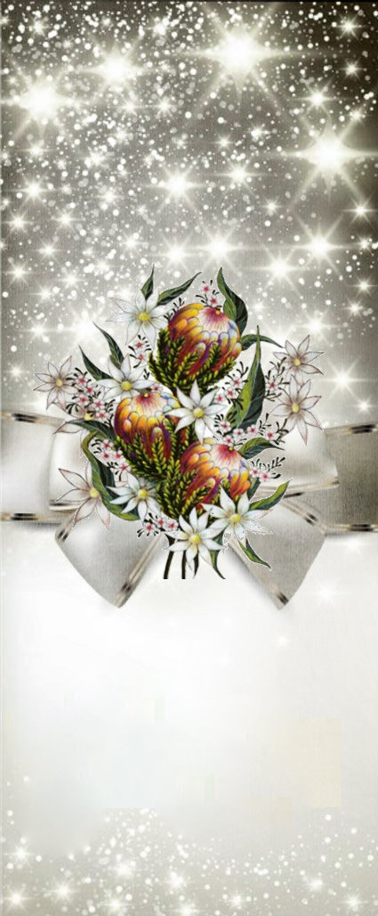
Join us for a FREE Christmas in July dinner & celebration.
There will be..
Music
Decorations
Gifts
Games
Activities for the kids
Christmas Dinner
and
Special guest performers- J.A.M (with music & puppets)
Australian
White Christmas
FREE tickets are available from the church & Second Chance Op Shop
Sunday, July 7
4:30 – 6:30pm
Spaces are limited so order your tickets quickly.

