Slide 1
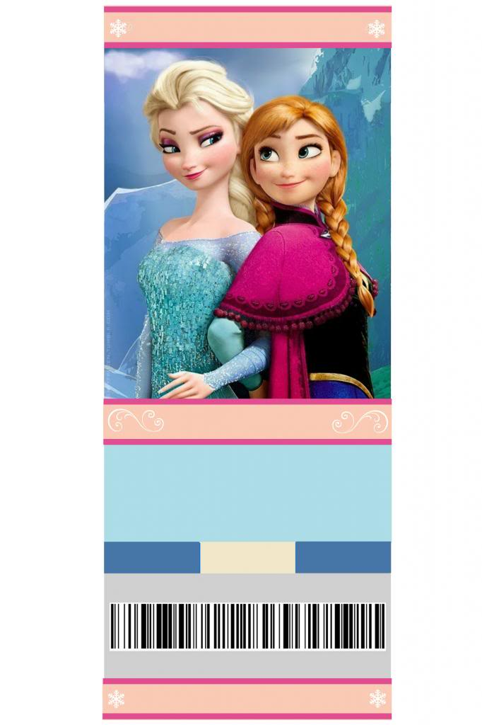
VIP PASS
VIP PASS
Do you want to meet a Saviour?
Do you want to meet a Saviour?
YOU’RE INVITED
YOU’RE INVITED
Unfrozen Christmas
Unfrozen Christmas
Drama-Music-Food
Drama-Music-Food
101 CARARITA RD BOGANGAR
101 CARARITA RD BOGANGAR
DAY
TIME
MONTH
DAY
TIME
MONTH
SUN 7
9:30 A
DEC
SUN 7
9:30 A
DEC
MORE INFO @ WWW.TWEEDCCC.COM.AU
MORE INFO @ WWW.TWEEDCCC.COM.AU
ADMIT ONE
ADMIT ONE

